Slide 1
Maximizing Speedup through Self Tuning of Processor Allocation
T.D. Nguyen, R. Vaswani and J. Zahorjan
Proceedings of International Conference on Parallel Processing ‘96
Presenter: Joonsung Yook and Minwook Kim
2020.11.26.

Slide 2
Motivation
Monotonically increasing speedup
Almost impossible to achieve
Never
Speedup
Monotonic increasing
Goal
Majority
Number of allocated Processors

Slide 3
Motivation
Monotonically increasing speedup
Almost impossible to achieve
Never
Speedup
Monotonic increasing
Goal
Majority
Many parallel applications achieve maximum speedup
at some intermediate allocation.
Number of allocated Processors

Slide 4
Motivation
Static vs Dynamic Measurements
Optimal # of Processors
Time

Slide 5
Motivation
Static vs Dynamic Allocation
Colored areas representing speed-up that static allocation does not reflect
Optimal # of Processors
Time

Slide 6
Motivation
Static vs Dynamic Allocation
Colored areas representing speed-up that dynamic allocation does not reflect
Optimal # of Processors
Dynamic allocation reflects the achievable speed-up
better than static allocation.
Time

Slide 7
Motivation
Many parallel applications achieve maximum speedup at some intermediate allocation.
Dynamic allocation using dynamic measurement can achieve better speed-up than static allocation.
It may not be possible a priori to determine the best allocation.
No static allocation may be optimal for the entire execution lifetime of a job.

Slide 8
Principles
Dynamically measures job efficiencies at different allocations
Uses these measurements to calculate speedups
Automatically adjusts a job’s processor allocation to maximize its speedup

Slide 9
Principles
Dynamically measures job efficiencies at different allocations
Appropriate hardware support to dynamically measure application efficiencies.
Uses these measurements to calculate speedups
Automatically adjusts a job’s processor allocation to maximize its speedup

Slide 10
Principles
Dynamically measures job efficiencies at different allocations
Appropriate hardware support to dynamically measure application efficiencies.
Uses these measurements to calculate speedups
The method of golden sections (MGS) [IO] to find the best allocation
Automatically adjusts a job’s processor allocation to maximize its speedup

Slide 11
Measurements Intervals
Existing problems with time-based intervals
Instantaneous speedup measurement
Reflection of the characteristic of only a small section
Relatively long intervals of time
Difficult to determine what constitutes a sufficiently long period of time
limiting its effectiveness due to a long time for each step of the search

Slide 12
Measurements Intervals
Focusing on only iterative parallel applications
A characteristic shared by a large variety of scientific parallel
Empirical evidence showing that successive iterations tend to behave similarly
Equate a measurement interval to an application iteration.

Slide 13
Runtime Measurement
loss of efficiency in shared memory systems
parallelization overhead
per-processor initialization
work partitioning
synchronization
system overhead
page faults
clock interrupts
Idleness
load imbalance
synchronization constraints
communication
processor stalls while waiting for the cache line to be fetched
Cache
Cache
Cache
Cache
Cache Coherence
BUS
Bottleneck
Memory

Slide 14
Runtime Measurement
loss of efficiency in shared memory systems
parallelization overhead
per-processor initialization
work partitioning
synchronization
system overhead
page faults
clock interrupts
Idleness
load imbalance
synchronization constraints
communication
processor stalls while waiting for the cache line to be fetched
Typically small
Cache
Cache
Cache
Cache
Cache Coherence
BUS
Bottleneck
Memory

Slide 15
Runtime Measurement
Efficiency E(p)
speedup S(p)
measurement infrastructure
WT(p) the elapsed execution time at p processors
UT(p) the accumulated user-mode execution time
IT(p) the accumulated idle time
PST(p) the accumulated processor stall time
system overhead
Idleness
communication

Slide 16
Runtime Measurement
Collecting critical HW counters for system overhead and communication
Elapsed wall-clock time
Elapsed user-mode execution time
Accumulated processor stall time
Using Instrumentation for idle time
PRESTO and CThreads synchronization code to track elapsed idle time
Using the wall-clock hardware counter

Slide 17
Method of Golden Sections (MGS)
Technique for finding a maximum of a unimodal function inside a specified interval.
By successively narrowing the range of values, it will converge to the maximum point

Slide 18
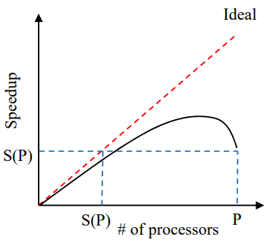
Basic Self-Tuning Algorithm (1)
Single variable optimization problem
Adjustable factor : # of processors
Goal : Maximize Speedup
Notes:
P = available processors

Slide 19
Basic Self-Tuning Algorithm (1)
Single variable optimization problem
Adjustable factor : # of processors
Goal : Maximize Speedup
Assumption
Speedup is a single variable function, $S\left(p\right):I→R, where domain is \left[1,P\right]$
S(p) can be calculated by measuring E(p) for any one iteration
Notes:
P = available processors

Slide 20
Basic Self-Tuning Algorithm (1)
Single variable optimization problem
Adjustable factor : # of processors
Goal : Maximize Speedup
Assumption
Speedup is a single variable function, $S\left(p\right):I→R, where domain is \left[1,P\right]$
S(p) can be calculated by measuring E(p) for any one iteration
Observation
Most speedup functions are unimodal
Notes:
P = available processors

Slide 21
Basic Self-Tuning Algorithm (2)
Reducing search interval
S(p) can never be super-linear, always $S\left(p\right)≤p$
If a function $F$ linearly increases in $[0, x]$, $F\left(x\right)=F\left(0\right)+x$
S is a non-superlinear function, so for $∀p∈\left[0, x\right]$ $S\left(p\right)≤S\left(0\right)+x$
Also, $S\left(0\right)=0 → S\left(p\right)≤x$
In the case of $x=S(P)$, for the interval $∀p∈\left[0, S\left(P\right)\right], S\left(p\right)≤S(P)$
Thus we don’t have to care about $[0, S\left(P\right)]$ Reduced search interval is $[S\left(P\right)+1, P]$
Notes:
super-linear: 선형보다 빠르게 증가하는 함수

Slide 22
Basic Self-Tuning Algorithm (2)
Reducing search interval
S(p) can never be super-linear, always $S\left(p\right)≤p$
If a function $F$ linearly increases in $[0, x]$, $F\left(x\right)=F\left(0\right)+x$
S is a non-superlinear function, so for $∀p∈\left[0, x\right]$ $S\left(p\right)≤S\left(0\right)+x$
Also, $S\left(0\right)=0 → S\left(p\right)≤x$
In the case of $x=S(P)$, for the interval $∀p∈\left[0, S\left(P\right)\right], S\left(p\right)≤S(P)$
Thus we don’t have to care about $[0, S\left(P\right)]$ Reduced search interval is $[S\left(P\right)+1, P]$
Notes:
super-linear: 선형보다 빠르게 증가하는 함수

Slide 23
Basic Self-Tuning Algorithm (2)
Reducing search interval
S(p) can never be super-linear, always $S\left(p\right)≤p$
If a function $F$ linearly increases in $[0, x]$, $F\left(x\right)=F\left(0\right)+x$
S is a non-superlinear function, so for $∀p∈\left[0, x\right]$ $S\left(p\right)≤S\left(0\right)+x$
Also, $S\left(0\right)=0 → S\left(p\right)≤x$
In the case of $x=S(P)$, for the interval $∀p∈\left[0, S\left(P\right)\right], S\left(p\right)≤S(P)$
Thus we don’t have to care about $[0, S\left(P\right)]$ Reduced search interval is $[S\left(P\right)+1, P]$
Notes:
super-linear: 선형보다 빠르게 증가하는 함수

Slide 24
Basic Self-Tuning Algorithm (2)
Reducing search interval
S(p) can never be super-linear, always $S\left(p\right)≤p$
If a function $F$ linearly increases in $[0, x]$, $F\left(x\right)=F\left(0\right)+x$
S is a non-superlinear function, so for $∀p∈\left[0, x\right]$ $S\left(p\right)≤S\left(0\right)+x$
Also, $S\left(0\right)=0 → S\left(p\right)≤x$
In the case of $x=S(P)$, for the interval $∀p∈\left[0, S\left(P\right)\right], S\left(p\right)≤S(P)$
Thus we don’t have to care about $[0, S\left(P\right)]$ Reduced search interval is $[S\left(P\right)+1, P]$
Notes:
super-linear: 선형보다 빠르게 증가하는 함수

Slide 25
Basic Self-Tuning Algorithm (2)
Reducing search interval
S(p) can never be super-linear, always $S\left(p\right)≤p$
If a function $F$ linearly increases in $[0, x]$, $F\left(x\right)=F\left(0\right)+x$
S is a non-superlinear function, so for $∀p∈\left[0, x\right]$ $S\left(p\right)≤S\left(0\right)+x$
Also, $S\left(0\right)=0 → S\left(p\right)≤x$
In the case of $x=S(P)$, for the interval $∀p∈\left[0, S\left(P\right)\right], S\left(p\right)≤S(P)$
Thus we don’t have to care about $[0, S\left(P\right)]$ Reduced search interval is $[S\left(P\right)+1, P]$
Notes:
super-linear: 선형보다 빠르게 증가하는 함수

Slide 26
Basic Self-Tuning Algorithm (2)
Reducing search interval
S(p) can never be super-linear, always $S\left(p\right)≤p$
If a function $F$ linearly increases in $[0, x]$, $F\left(x\right)=F\left(0\right)+x$
S is a non-superlinear function, so for $∀p∈\left[0, x\right]$ $S\left(p\right)≤S\left(0\right)+x$
Also, $S\left(0\right)=0 → S\left(p\right)≤x$
In the case of $x=S(P)$, for the interval $∀p∈\left[0, S\left(P\right)\right], S\left(p\right)≤S(P)$
Thus we don’t have to care about $[0, S\left(P\right)]$ Reduced search interval is $[S\left(P\right), P]$
Notes:
super-linear: 선형보다 빠르게 증가하는 함수

Slide 27
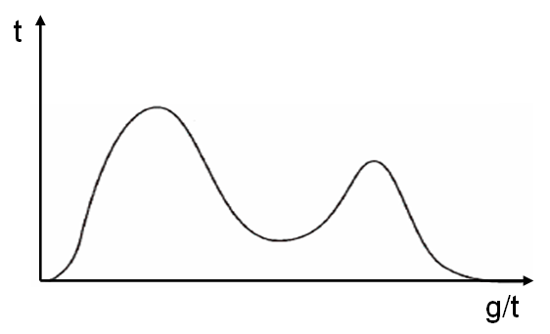
Basic Self-Tuning Algorithm (3)
Non-unimodal speedup functions
Simply do the same algorithm(MGS)
No guarantee to choose global maximum, but worked well in practice
Bimodal function example
Notes:
super-linear: 선형보다 빠르게 증가하는 함수

Slide 28
False Assumptions of Basic Self-tuning
Speedup is not a function of time
Problem: Job’s speedup function changes over time
Allocation found at the beginning of execution can be inappropriate later
The speedup values of successive iterations are directly comparable
Problem: Speedup is likely to vary from iteration to iteration
Such variations can cause basic self-tuning to converge to a sub-optimal allocation
Notes:
Basic self-tuning measures speedup values once at the beginning

Slide 29
False Assumptions of Basic Self-tuning
Speedup is not a function of time
Problem: Job’s speedup function changes over time
Allocation found at the beginning of execution can be inappropriate later
The speedup values of successive iterations are directly comparable
Problem: Speedup is likely to vary from iteration to iteration
Such variations can cause basic self-tuning to converge to a sub-optimal allocation
Notes:
Basic self-tuning measures speedup values once at the beginning

Slide 30
False Assumptions of Basic Self-tuning
Speedup is not a function of time
Problem: Job’s speedup function changes over time
Allocation found at the beginning of execution can be inappropriate later
The speedup values of successive iterations are directly comparable
Problem: Speedup is likely to vary from iteration to iteration
Such variations can cause basic self-tuning to converge to a sub-optimal allocation
Notes:
Basic self-tuning measures speedup values once at the beginning

Slide 31
False Assumptions of Basic Self-tuning
Speedup is not a function of time
Problem: Job’s speedup function changes over time
Allocation found at the beginning of execution can be inappropriate later
The speedup values of successive iterations are directly comparable
Problem: Speedup is likely to vary from iteration to iteration
Such variations can cause basic self-tuning to converge to a sub-optimal allocation
Notes:
Basic self-tuning measures speedup values once at the beginning

Slide 32
False Assumptions of Basic Self-tuning
Speedup is not a function of time
Problem: Job’s speedup function changes over time
Allocation found at the beginning of execution can be inappropriate later
The speedup values of successive iterations are directly comparable
Problem: Speedup is likely to vary from iteration to iteration
Such variations can cause basic self-tuning to converge to a sub-optimal allocation
Notes:
Basic self-tuning measures speedup values once at the beginning

Slide 33
Refining the basic Self-Tuning approach
Change-driven self-tuning algorithm (CST)
Monitor job efficiency and rerun the search procedure, whenever a significant change in efficiency occurs

Slide 34
Refining the basic Self-Tuning approach
Change-driven self-tuning algorithm (CST)
Monitor job efficiency and rerun the search procedure, whenever a significant change in efficiency occurs
Time-driven self-tuning algorithm (TST)
Job efficiency can change in the middle of CST search
Includes change-driven self-tuning, also rerun the search procedure periodically regardless of change in job efficiency

Slide 35
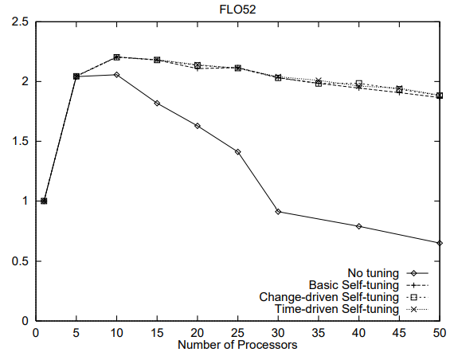
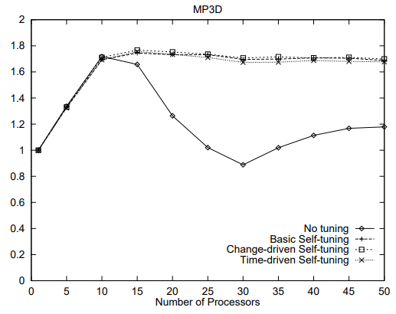
Performance - Improvement
Basic self-tuning often significantly improves performance over no tuning
basic,
CST,
TST
basic,
CST,
TST
no
no

Slide 36
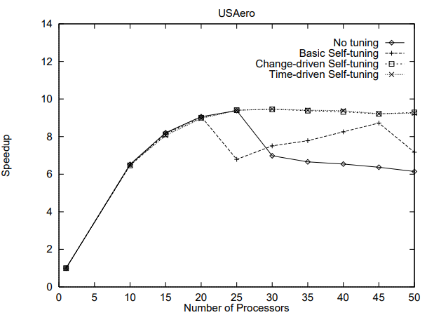
Performance - CST
Change-driven self-tuning can improve performance over basic self-tuning
CST, TST
basic
no
Notes:
As mentioned in Section 4.2, basic self-tuning is fairly static in that once an allocation is chosen, it remains unchanged for the lifetime of the job. If the job’s speedup characteristics change over time, this rigid allocation choice can result in poorer performance than could be gained by reevaluating the choice when the change is noticed. As seen in Figure 3, the performance of USAero, an application whose speedup does change with time, is indeed enhanced by such change-driven self-tuning.

Slide 37
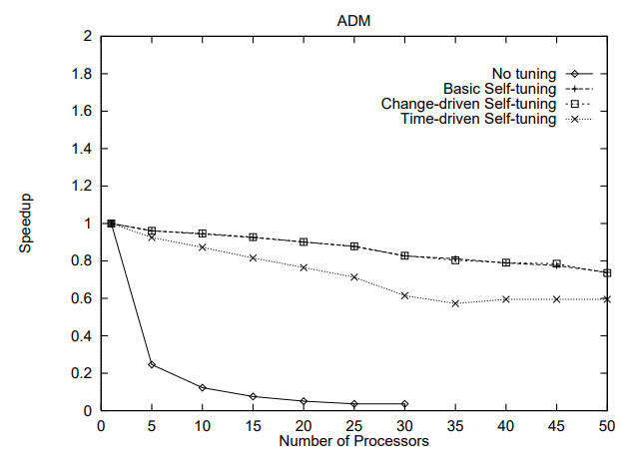
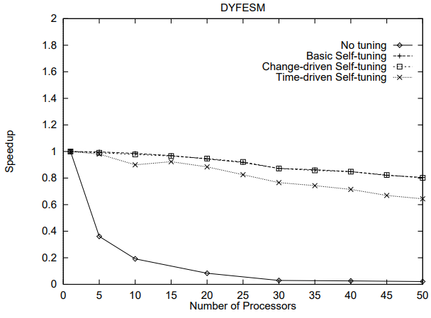
Performance - TST
Time-driven self-tuning is not useful for the applications studied here
Jitter in measured iteration efficiencies appears to be small enough so that does not cause problems
basic, CST
basic, CST
TST
TST
Notes:
As discussed in Section 4.2, time-driven self-tuning is meant to address the situation in which jitter in consecutively measured iteration efficiencies causes the search procedure to choose poorly. For the applications available to us, this jitter appears to be small enough so that this basic instability in the search procedure does not cause problems; given this, periodically initiating self-tuning imposes overhead that yields performance poorer than gained via either basic or change-driven self-tuning.

Slide 38
Multi-phase Self-tuning
Each phase may have a distinct ideal number of processors
Phase: components of an iteration
A parallel loop in a compiler-parallelized program
A subroutine in a hand-coded parallel program
Goal
Find a processor allocation vector (p1, p2, ..., pN) that maximizes performance when there are N phases in an iteration
Assume
On each entry to and exit from a phase, the runtime system is provided with the unique ID of the phase

Slide 39
Multi-phase Self-tuning
Independent multi-phase self-tuning
Apply self-tuning to each phase independently, using the same search technique as before
Problem
Performance of each phase also depends on the allocations for other phases
Notes:
This randomized acceptance of seemingly unpromising candidates is a key aspect of simulated annealing approaches, as it allows them to escape from local optima in order to find a better, global optimum.

Slide 40
Multi-phase Self-tuning
Inter-dependent multi-phase self-tuning
Simulated annealing and a heuristic-based approach
Randomized search technique
Choosing an initial candidate allocation vector (same as independent MPST)
Selecting a new candidate vector (apply random multiplier to initial vector)
Evaluating and accepting new candidate vectors until steady state
Terminating the search
Details on: https://dada.cs.washington.edu/research/tr/1995/09/UW-CSE-95-09-02.pdf
Notes:
This randomized acceptance of seemingly unpromising candidates is a key aspect of simulated annealing approaches, as it allows them to escape from local optima in order to find a better, global optimum.

Slide 41
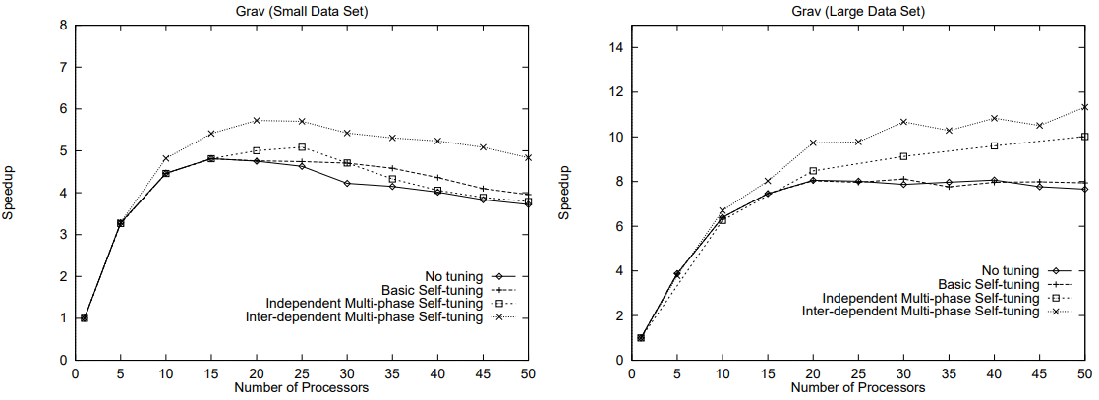
Performance – Multi-phase self-tuning
Multi-phase techniques are able to achieve better performance than single value allocation
Inter-dependent self-tuning yields better performance than any other
Inter-dep. MPST
Inter-dep. MPST
Indep. MPST
Indep. MPST,
basic, no
basic, no

Slide 42
Conclusion
Many parallel applications achieve maximum speedup at some intermediate allocation
Dynamic measurement for program inefficiencies
Basic self-tuning finds optimal point by using MGS
CST and TST can handle the change in speedup over time
MPST is capable of fine-grained allocation in phase units

Slide 43
Thank you

Slide 44
Backups

Slide 45
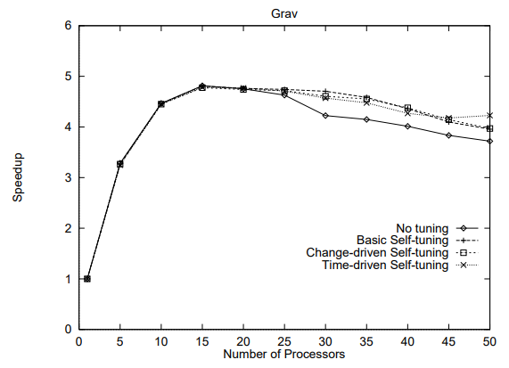
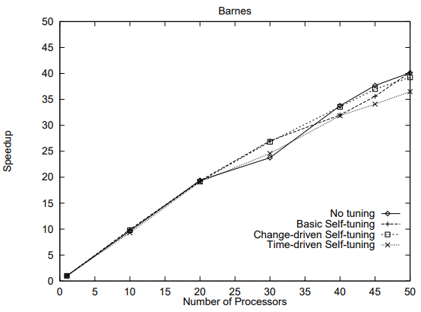
Performance - Overhead
Self-tuning imposes very little overhead
Every form of self-tuning shows similar performance
Notes:
Hand -coded
These applications continue to exhibit good speedup even when using (all forms of) self-tuning, with the curves for the self-tuning policies falling close to or on top of the original (no tuning) speedup curves.

Slide 46
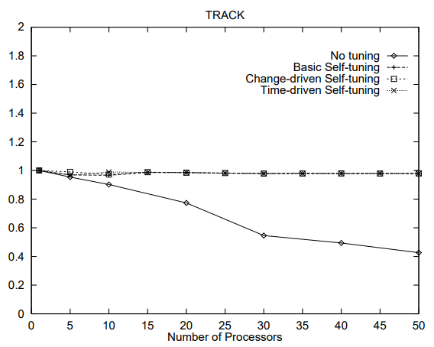
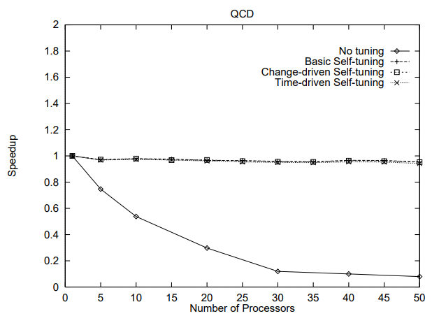
Performance – Searching cost
The performance benefit of self-tuning can be limited by the cost of probes
If searching scope [S(P ), P] is large, speedup degrades due to the cost of the searching procedure

